Slide 1
Insurance case
Study
Exploratory data analysis.

Slide 2
Overview
Insurance case study dataset contains :
Respondent - data type (Number)
ConceptRating - data type (Categorical , Number)
CurrentInsuranceSupplier - data type (Categorical , Text)
Age - data type (Number)
MaritalStatus - data type (Categorical , Text)
NumberofCars - data type (Categorical , Number)
AverageAgeofCars - data type (Number)
NumberofTrips - data type (Categorical , Number)

Slide 3
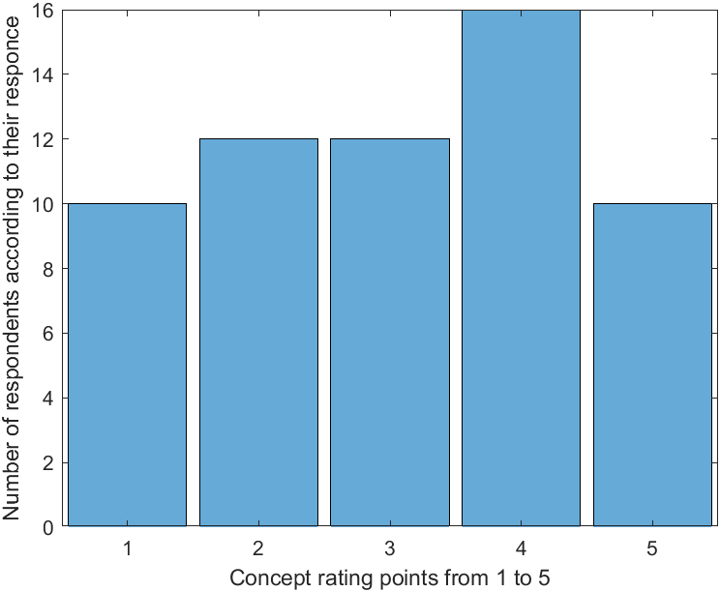
Graph : Histogram
X-axis : Rating from 1 to 5
Y-axis : No. of respondents according to each points

Slide 4
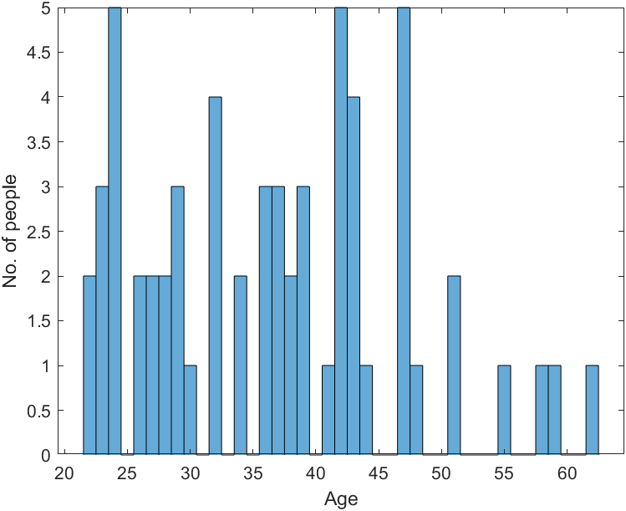
Graph : Histogram
X-axis : Age
Y-axis : No. of People according to each age group

Slide 5
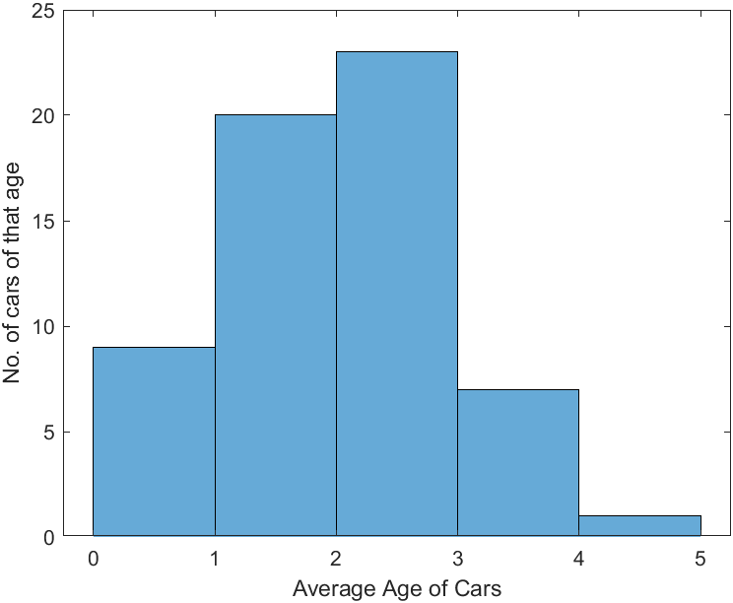
Graph : Histogram
X-axis : Average age of cars
Y-axis : No. of cars in each age group

Slide 6
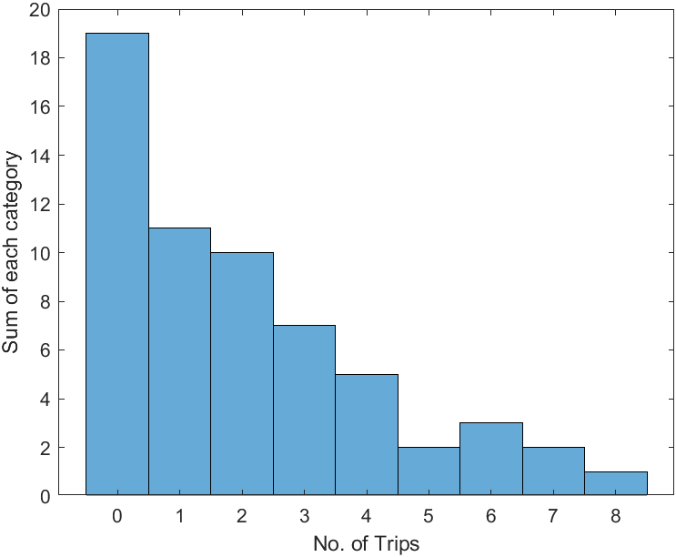
Graph : Histogram
X-axis : No. of Trips
Y-axis : Sum of trips according to each category

Slide 7
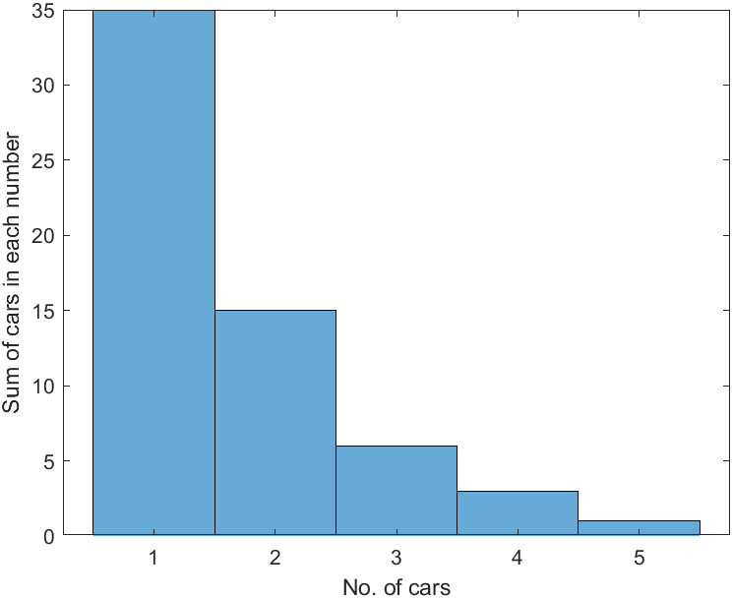
Graph : Histogram
X-axis : No. of cars
Y-axis : Sum of cars according to each category

Slide 8
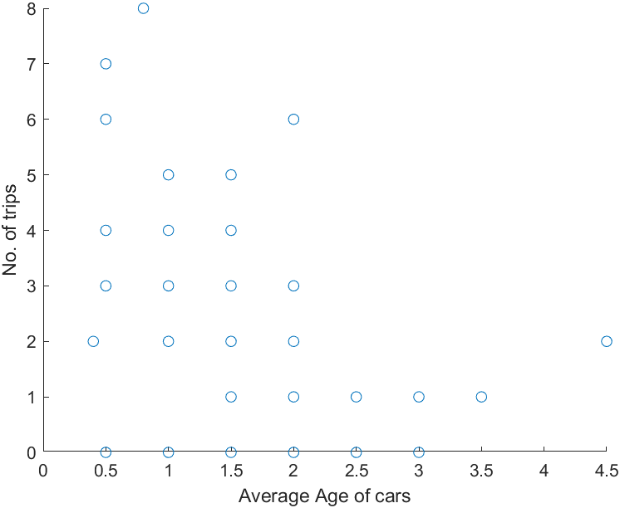
Graph : Scatter
X-axis : Average age of cars
Y-axis : No. of trips

Slide 9
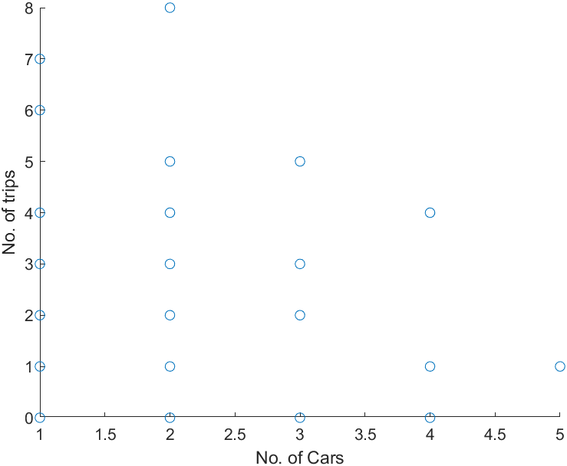
Graph : Scatter
X-axis : No. of cars
Y-axis : No. of trips

Slide 10
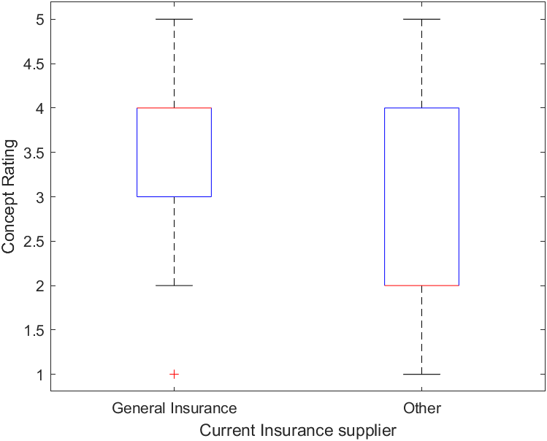
Graph : Box plot
X-axis : Current insurance supplier
Y-axis : Concept rating

Slide 11
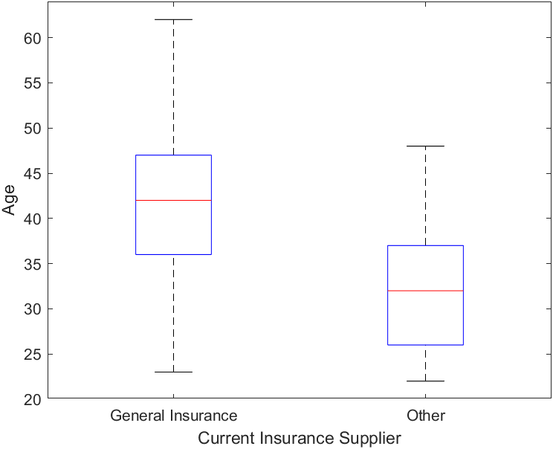
Graph : Box plot
X-axis : Current insurance supplier
Y-axis : Age of peoples

Slide 12
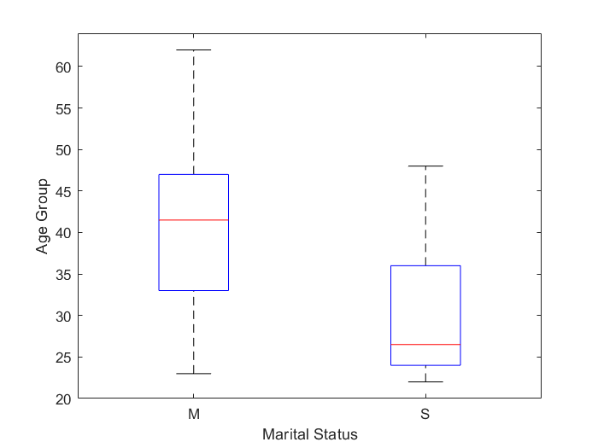
Graph : Box plot
X-axis : Marital status
Y-axis : Age group

Slide 13
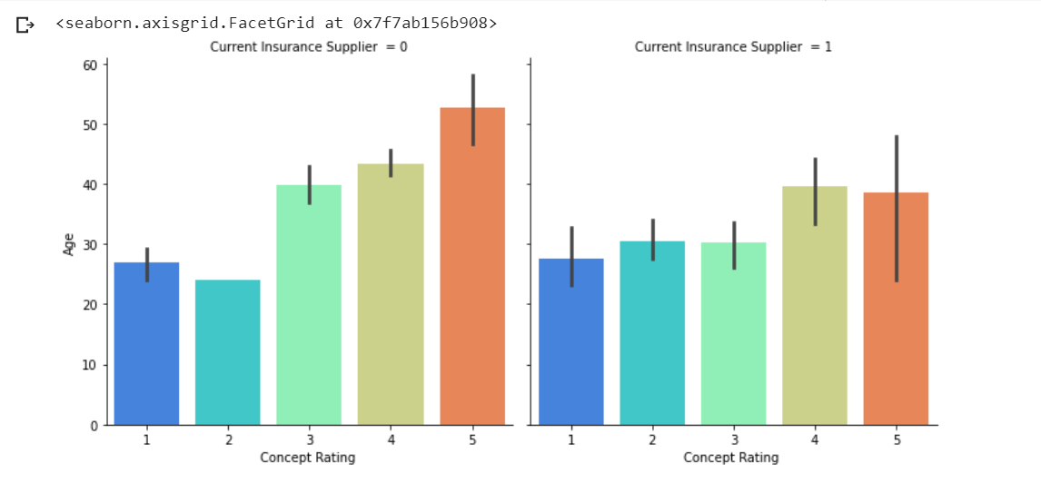
Graph : Cat Plot
X-axis : Concept rating
Y-axis : Age
1st Graph: General Insurance
2nd Graph: Other Insurance

Slide 14
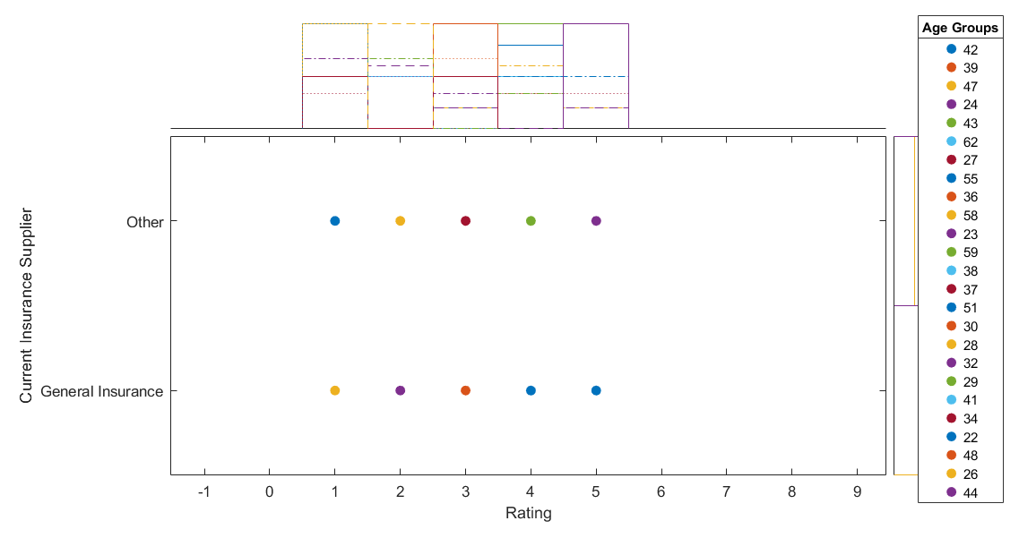
Graph : Scatter histogram
X-axis : Concept rating
Y-axis : Current insurance provider
Colours: Different Age groups

Slide 15
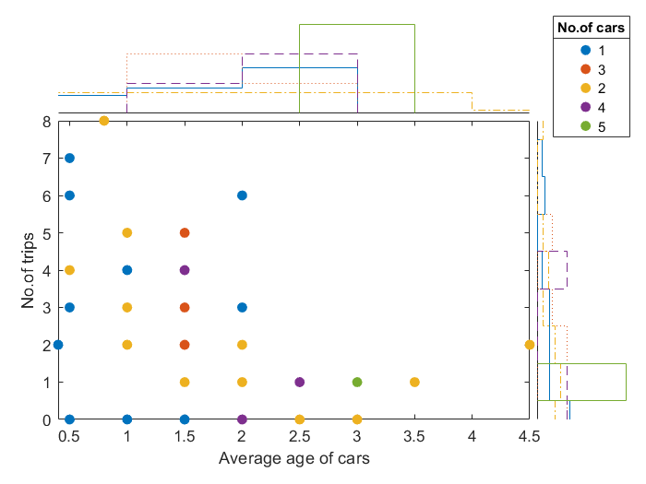
Graph : Scatter histogram
X-axis : Average age of cars
Y-axis : No. of trips
Colours: No. of cars for that specific person

Slide 16
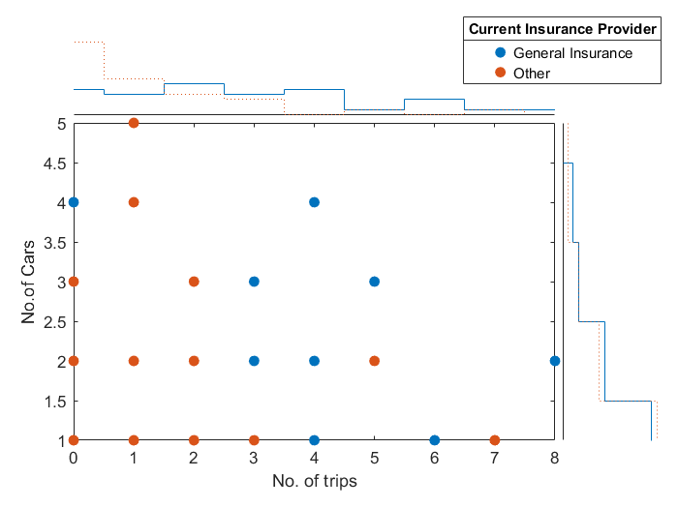
Graph : Scatter histogram
X-axis : No.of trips
Y-axis : No. of cars
Colours: Current insurance provider

Slide 17
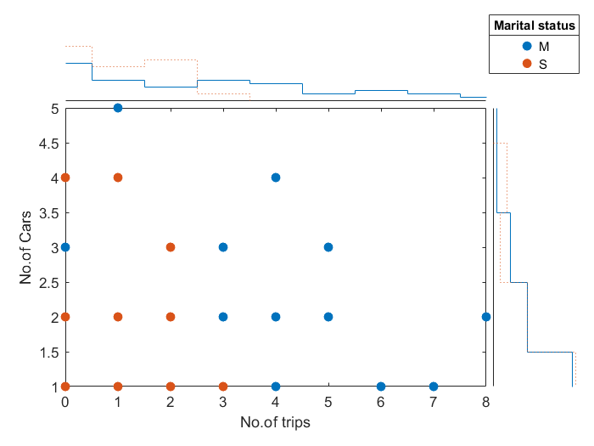
Graph : Scatter histogram
X-axis : No. of trips
Y-axis : No. of cars
Colours: Marital status

Slide 18
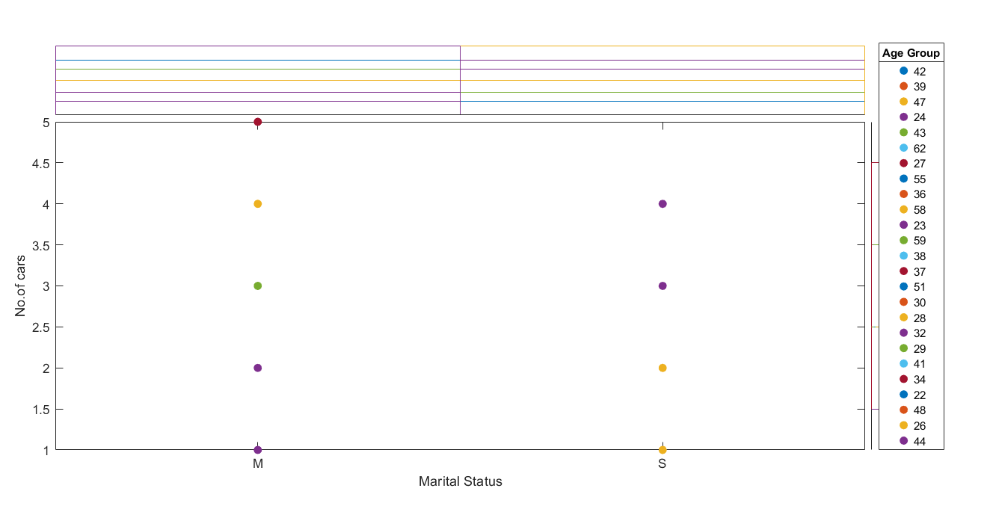
Graph : Scatter histogram
X-axis : Marital status
Y-axis : No. of cars
Colours: Different Age groups

Slide 19
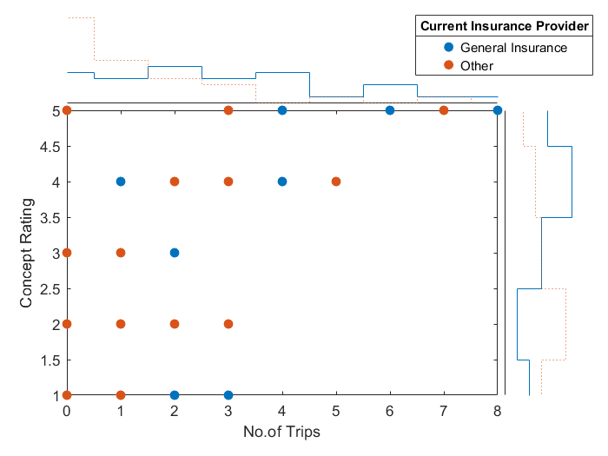
Graph : Scatter histogram
X-axis : No. of trips
Y-axis : Concept rating
Colours: Current insurance provider

Slide 20
Thank you.

